Slide 1
Explaining customer ratings and recommendationsby
combining qualitative and quantitative user generated contents (UGC)
Prof. Swagato Chatterjee
Vinod Gupta School of Management, IIT Kharagpur

Slide 2
Contents
Introduction
Project outline
Research Questions
Project model
Text mining process
Methodology
Conclusion

Slide 3
Introduction
User Generated Content (UGC)
Important Performance Indicators
Useful for measurement of customer satisfaction (CSAT)
Source of Information for potential uninformed customers
Customer Ratings
Customer Recommendations
Online Review Systems

Slide 4
Customer Perception:
Happy customer → Positive Feedback
Angry customer→ Negative Feedback
More and more customers are engaging in sharing information on online platforms
An organization should focus on dealing with both positive and negative feedbacks along with repercussions.
In this project : Qualitative + Quantitative UGC of online airline data
To find:
what explains customer ratings and recommendations

Slide 5
Project Outline
Step 1 : Text mining
Step 2: Text analysis
Find the aspects of core services
Find the aspects of augmented services
Analysis based on different contexts
Relative importance of service attributes and emotions vary for different types of consumers based on the service context. (Full service, low cost airlines, leisure, etc.

Slide 6
Research Questions
The core service
Include the basic benefits that a service provides;
Example: Food in a restaurant vis a vis the value for money it provides.
Augmented service
include aspects that ‘differentiate’ a service provider from its competitors
Example: The ambience, music, parking facility etc.
In our context, we try to analyze how the core and augmented service aspects impact customer satisfaction and recommendation behavior
RQ1. Do the ratings given about core and augmented service aspects explain customer satisfaction and recommendation behavior?

Slide 7
Research Questions
Emotions may not be necessarily one dimensional like sentiments.
Emotions can be in an amalgamation or in a singular form in order to express distinct psychological process in consumer mind.
Emotions with high explanatory power:
Anger, Fear
Emotions with high explanatory power:
Trust, Anticipation
Textual reviews represent customer’s experience about his/her service experience.
RQ2. Do the overall sentiment and emotions expressed in textual reviews explicitly explain a customer's satisfaction and recommendation behavior?

Slide 8
Research Questions
Ratings provide a quantitative measure of consumers' satisfaction with both the core and augmented service aspects
consumers tend to express their feelings on the service aspects through textual reviews
Also, core service aspects have different explanatory power than augmented service aspects. Hence, different explanatory power would have different impact.
RQ3. Does a sentiment related to the core and augmented service aspects effectively explain customer satisfaction and recommendation behavior?

Slide 9
Research Questions
The explanatory powers of various attributes vary depending on whether the business model is full service or low cost .
Low cost airlines:
‘No frills’ and provides just the core benefits at a lower cost
For every extra service, there is an additional cost.
Full service airlines:
include all the associated services of airlines such as club, lounge, restaurant, priority
RQ4. How does the above-mentioned explaining power change based on the model of service?

Slide 10
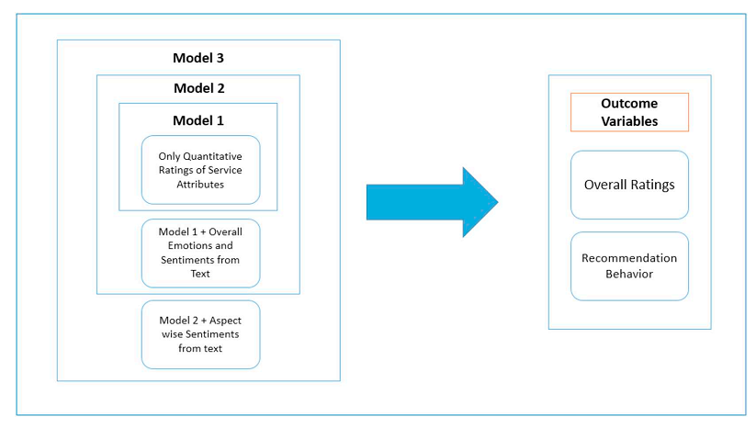
Project Model

Slide 11
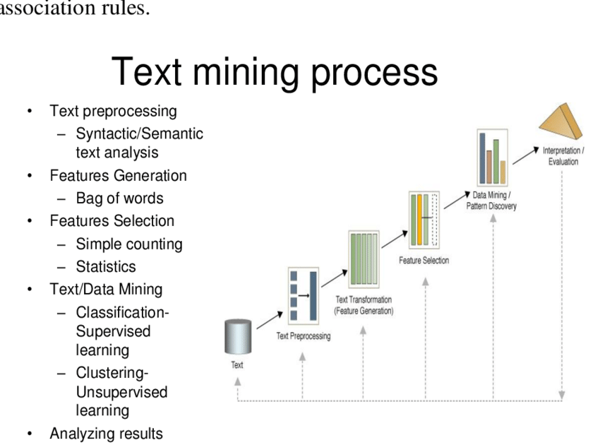
Text Mining Process

Slide 12
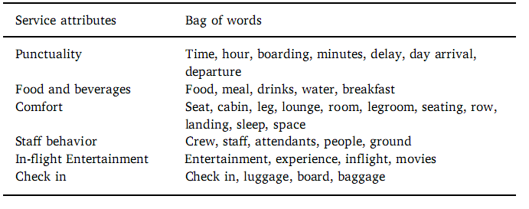
Methodology
Data Collection: airlinequality.com
Total Reviews: 41397 customer reviews of 362 airlines from 158 countries
Scale: 1 to 10-point scale [1: Highly dissatisfied] :
[10:Highly satisfied]
In our study we have used NRC Word-Emotion Association Lexicon (also called EmoLex) created by Mohammad and Turney.
It provides scores about the following sentiments and emotions
sentiments: negative, positive; emotions: anger, anticipation, disgust, fear, joy, sadness, surprise, trust
Overall Frequency Measurement: (pos- neg)/(pos+neg)
pos= frequency of positive words
neg= frequency of negative words

Slide 13
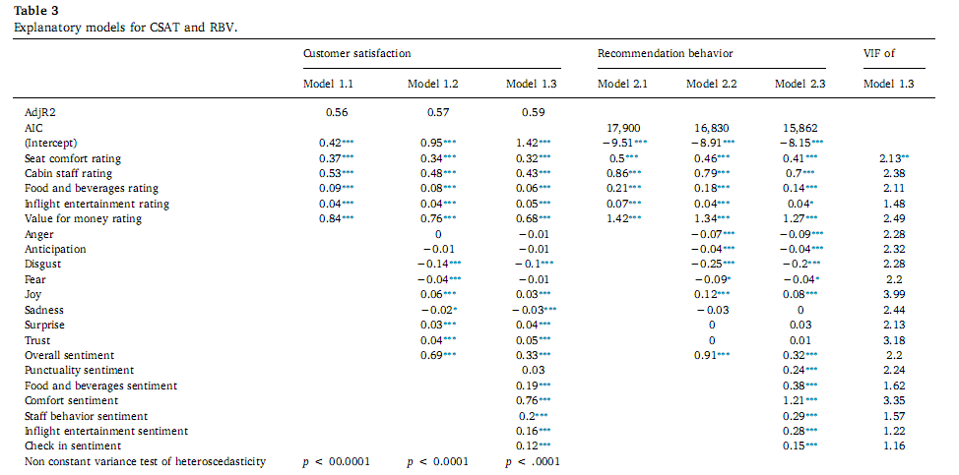
Results

Slide 14
Conclusions:
Core aspects of a service have stronger positive relationships with CSAT and RBV than the ancillary aspects
The relative importance of concrete service aspects such as value for money is higher in case of low-cost airlines in comparison to full service airlines.
The relative importance of abstract service aspects such as seat comfort, cabin staff behavior food and beverages, in-flight entertainment etc. are higher for full service airlines.
Most of the aspect-wise sentiment scores have positive relationship with consumer outcomes related to full service airlines, and not related to low cost airlines.
The relationship of emotions with consumer outcomes is stronger for full service airlines.
Managerial Implications:
Service contexts which are abstract should focus more on textual reviews
Concrete service contexts should focus more on quantitative rating based feedback collection system

